Slide 1
Import Many Files

Slide 2
Credit Source
Reading and Processing the Contents of a Directory
Ben Cochran, The Bedford Group, Raleigh, NC

Slide 3
TLDR
Create a dataset with file names as observations
Create a macro for proc import
Use Call Execute to perform a macro call for each file

Slide 4
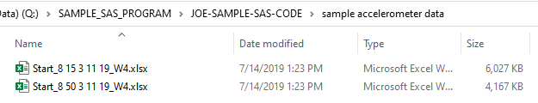
Directory

Slide 5
Directory Functions
DOPEN - opens a directory and returns the directory identifier
DNUM - returns the number of members in a directory
DREAD - returns the name of a directory member (file or folder)
DCLOSE - closes a directory opened by DOPEN

Slide 6
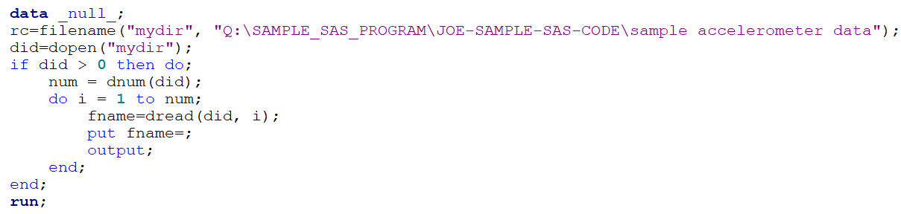
Proof on concept
Notes:
Filename( ) assigns reference name like libname

Slide 7
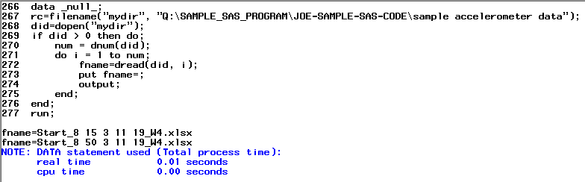
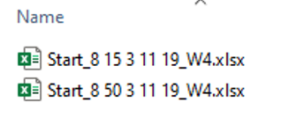
Log

Slide 8
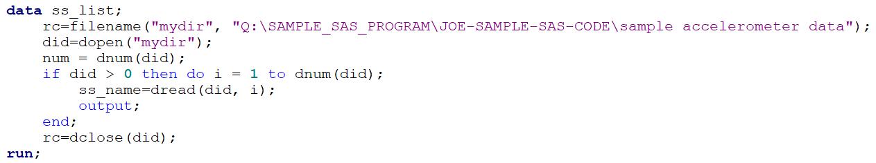
Observation for each file name

Slide 9

Step 2 proc print

Slide 10
Simple proc import

Slide 11
Simple proc import

Slide 12
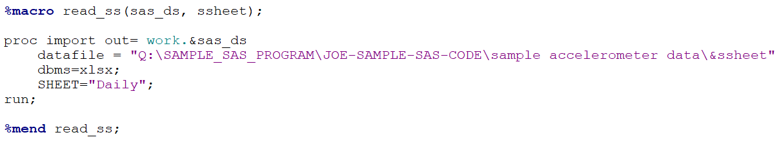
Macro of proc import

Slide 13
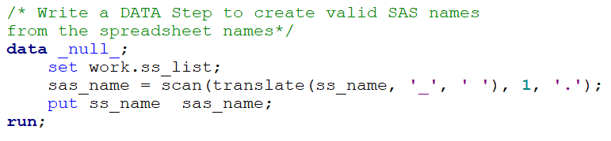
Valid SAS Dataset Names

Slide 14
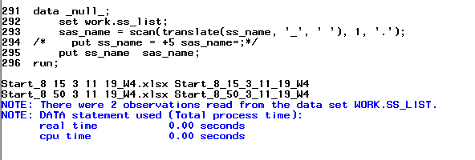
Log

Slide 15
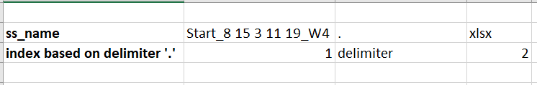
Scan()

Slide 16
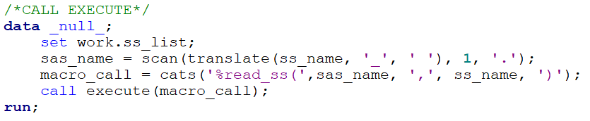
Call Execute

Slide 17
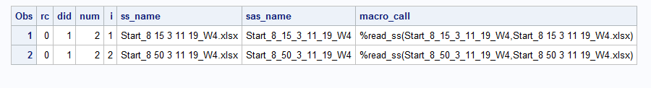
Cats()

Slide 18


Proc Import Log

Slide 19
Summary
Create a dataset with file names as observations
Create a macro for proc import
Use Call Execute to perform a macro call for each file

Slide 20
End

Slide 21
